Slide 1
Fake News Detection
Group 1: Amelia Mazer, Jhaanvi Golani, Mengzhen Wang, Tomas Ricardo

Slide 2
Introduction
Problem
1
With an increasing number of news platforms sources that can spread misinformation
Motivation
2
We were hired by Google to see how accurate machine learning models can be to identify fake news vs real news
Dataset
3
Our dataset is about fake and true news we found from Kaggle to test how well our models will be

Slide 3
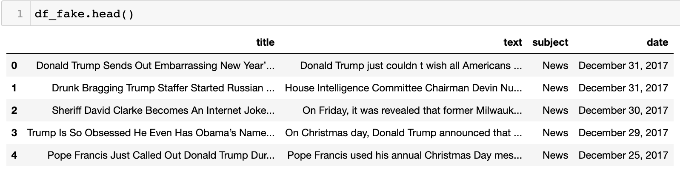
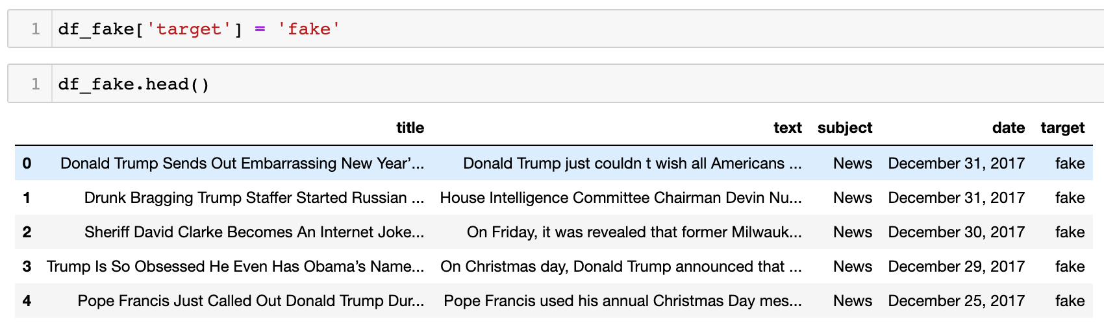
Dataset Fake CSV

Slide 4
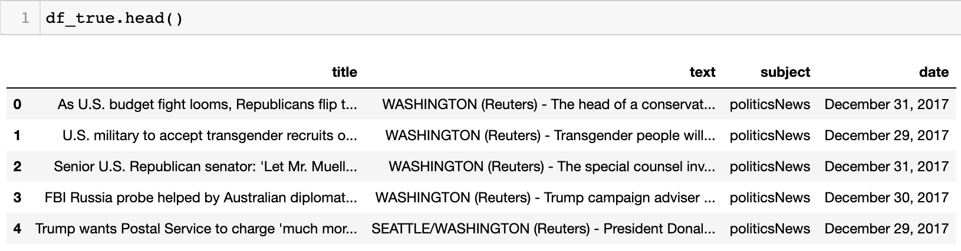
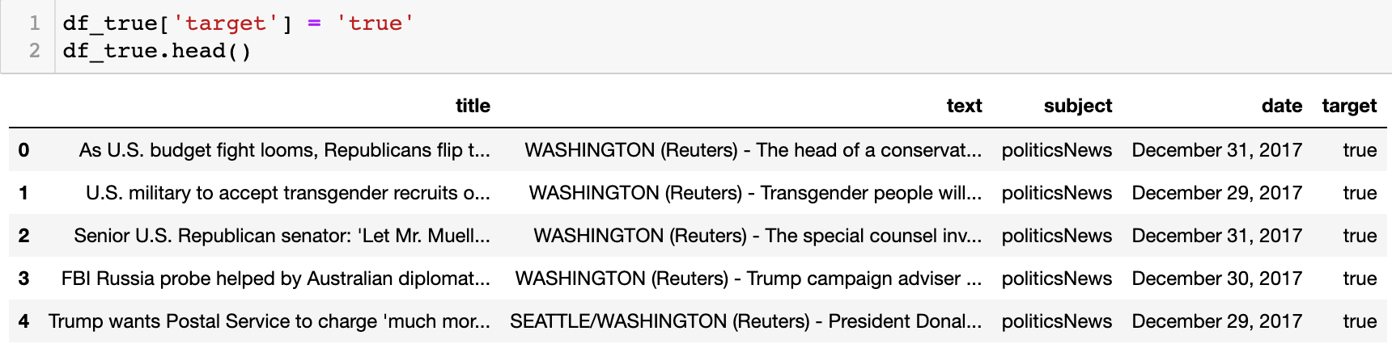
Dataset True CSV

Slide 5
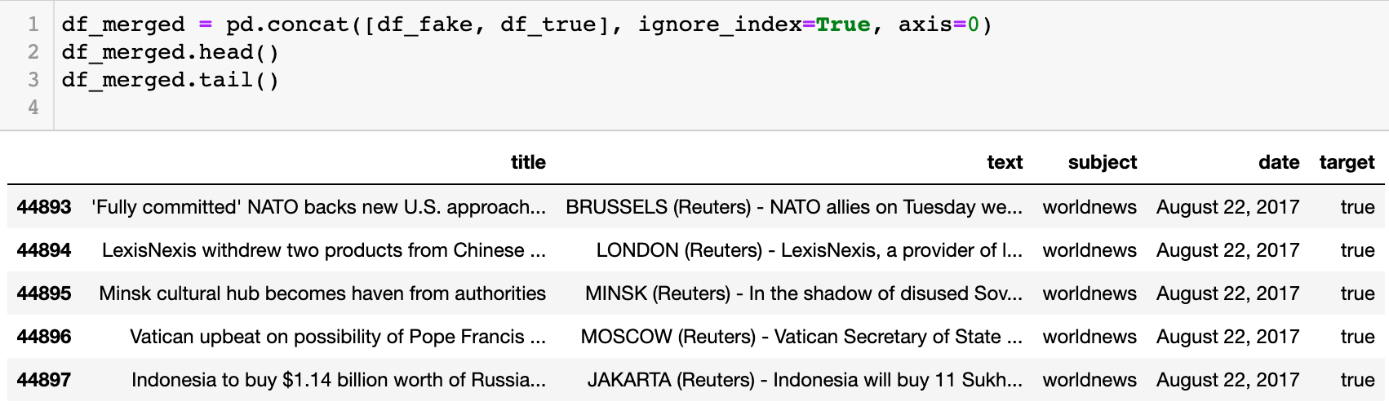
Merging the two Datasets

Slide 6
Data
Preprocessing

Slide 7
Data Preprocessing
Date Parsing
Text Cleaning
1
2
Notes:
In data preprocessing, we covered two main categories - one was date parsing and the other was text cleaning on which we’ll talk about in the next slides

Slide 8
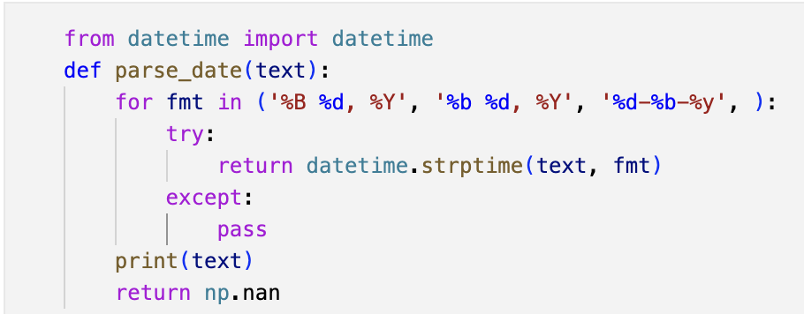
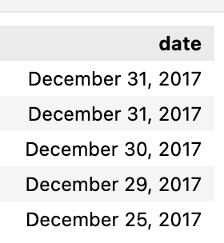
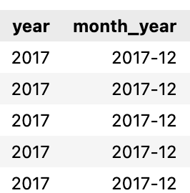
Date Parsing
Parsing dates and removing text rows from date column:
Extracting year and year month information from date column
Notes:
We wanted to use date as one of our features so initially Date column here was read as a string data type and with three different formats so to make it consistent, we had to parse it and convert it into date time format , for that used this piece of code where were are giving it these different formats to parse text into datetime and if none of the format matches, we return nan for these rows. After we converted date column to datetime we extract year and month year from it shown over here.

Slide 9
Text Cleaning and processing
Tokenization
Hyperlinks/URL
Non-Dictionary Words
HTML Tags
Stop words
Whitespace
(new line, tabs, spaces)
Punctuations
Lemmatization
Notes:
The next step for us was text cleaning - we worked on removing hyperlinks, html tags, any whitespaces, punctuations. After that we tokenized the text into words, using word_tokenize function from nltk. Then we are removing any word which is non dictionary and stop words. Post that we are doing lemmatization which converts the word into root form so while computing term frequency their root form is considered

Slide 10
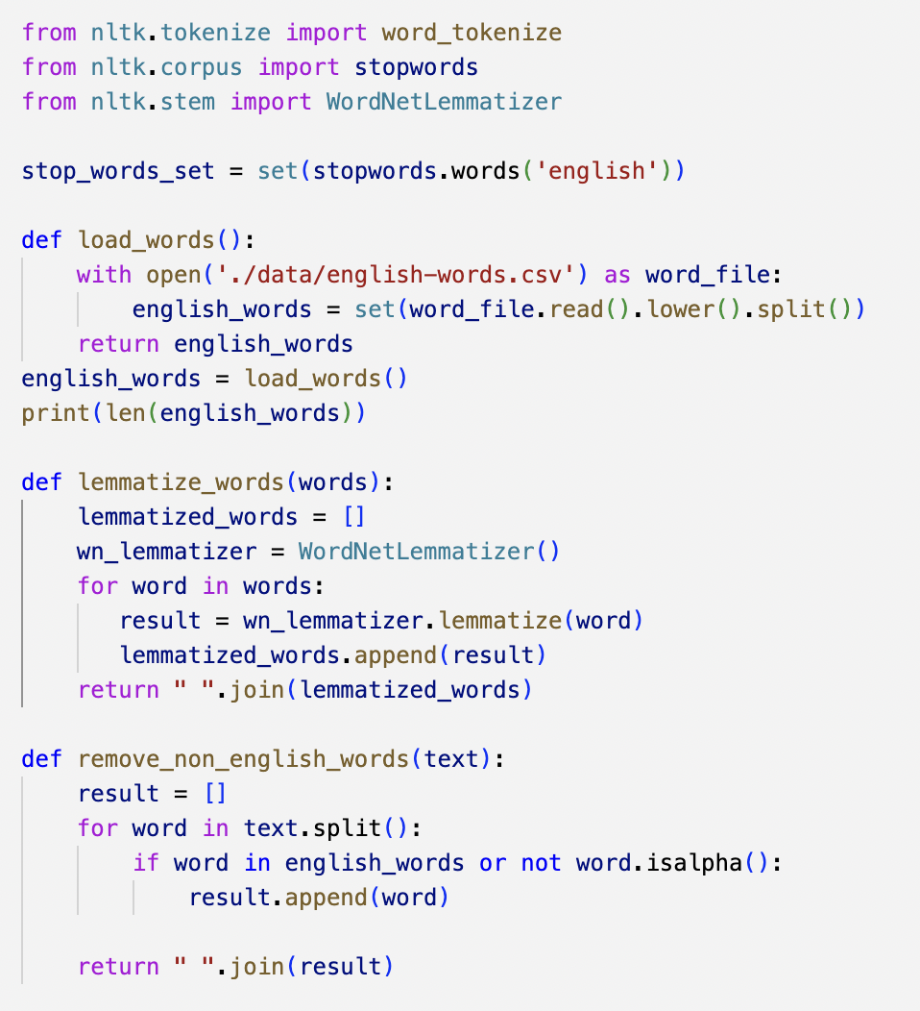
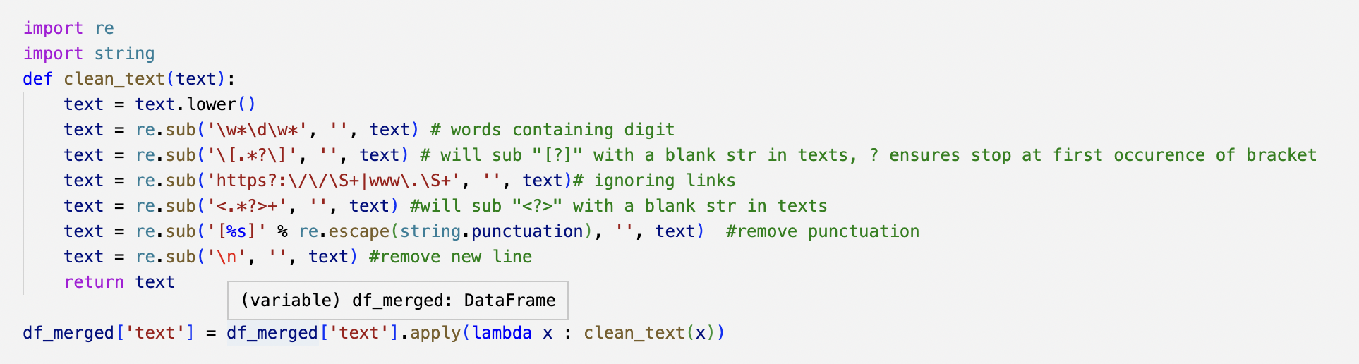
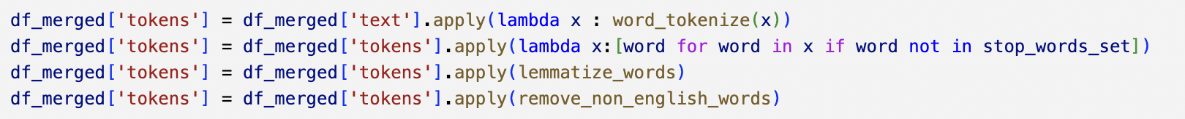
Text Processing
Text Cleaning
Notes:
These are the code snippets for text cleaning and preprocessing

Slide 11
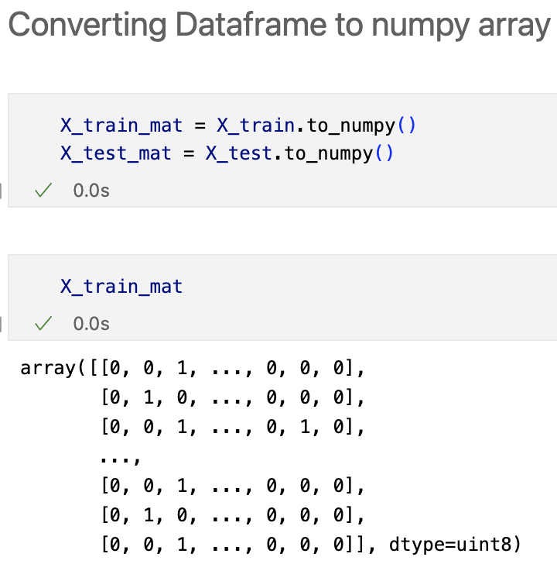
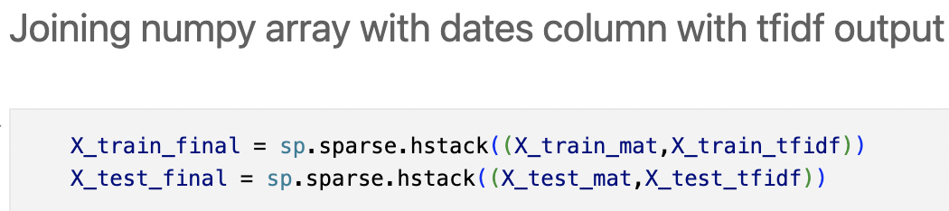
Appending the Data
Notes:
After preprocessing the data, we extracted the date features and used them in combination with the TF-IDF output. Since the TF-IDF output was in the form of a sparse matrix, we converted the resulting data frame to a numpy array. This allowed us to combine the date features with the TF-IDF output and obtain a final output in the form of an array

Slide 12
Exploratory Data Analysis
Notes:
Next, we performed some EDA in which we included plots, Word - clouds and topic models to know more about what kind of categories are coming up in the dataset

Slide 13
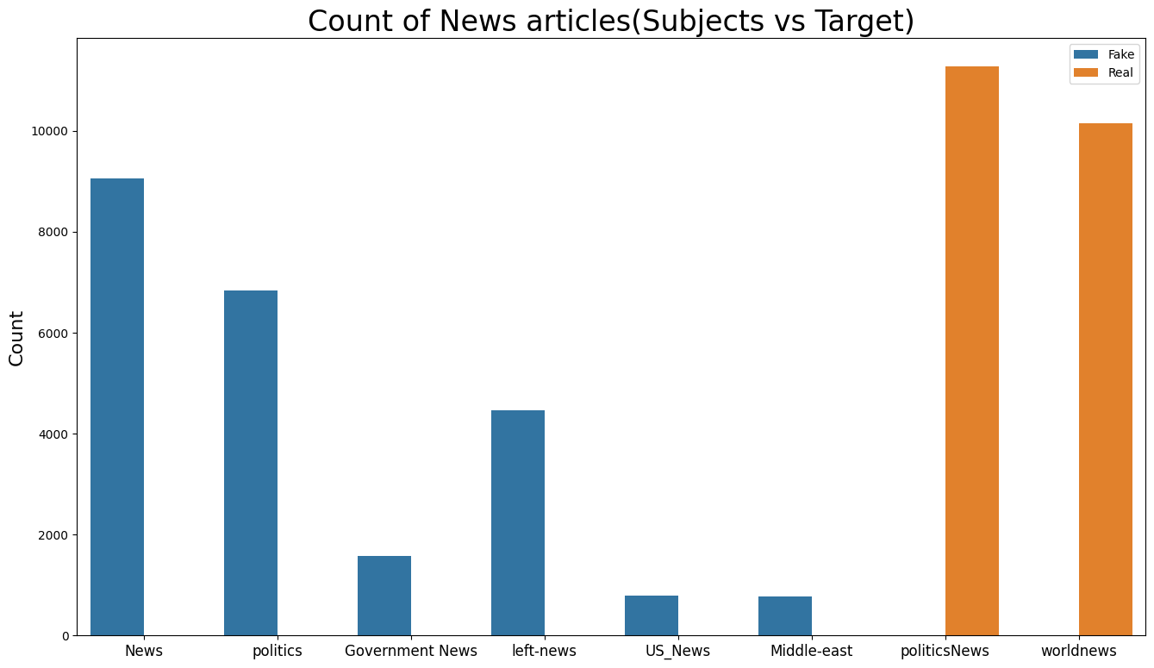
Insight - Looking at the plot above if we included subject as the feature, model would quickly realize which subjects correspond to real or fake news so dropping the 'Subject' column
Notes:
First we did a count plot to understand more about the column ‘subject’, we found there was a clear division between fake and real news as it is evident from the plot so we decided to drop it as the feature from our model training.

Slide 14
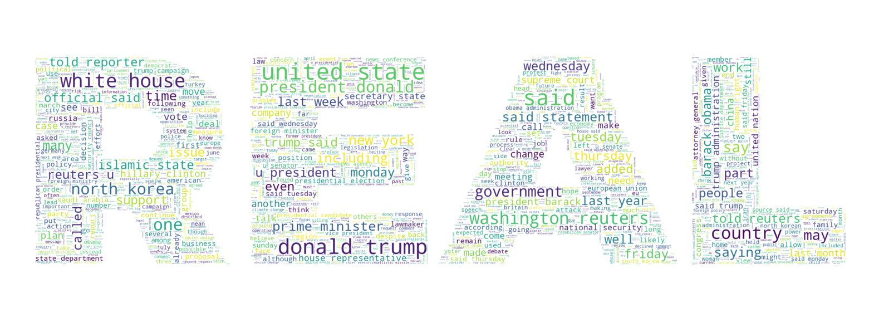
Notes:
Next we did some word cloud on text corpus of the real news and fake news. It contains both unigram and bigrams. Here we can see that in real news words like washington reuters, reuters,white house, barack obama, and government are more frequently occurring.

Slide 15
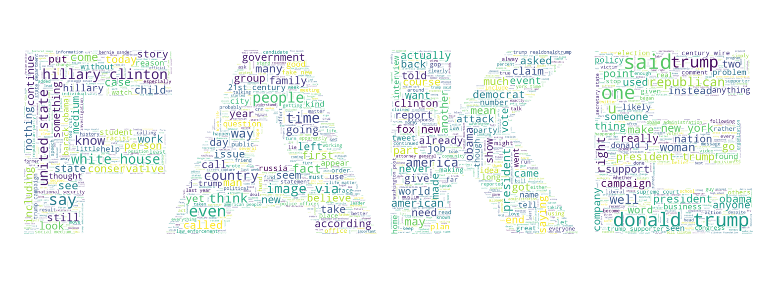
Notes:
While in fake news, we can see words like hillary clinton, trump more frequently occurring. While there are few words like donald trump, white house which are frequently occurring in both.

Slide 16
Word Embedding Techniques
Bag Of Words
Frequency of words in document.
1
TF-IDF
Measures how important a word is to a document.
2
For feature extraction, to better understand underlying topic present in text
Bag of words + LDA
3

Slide 17
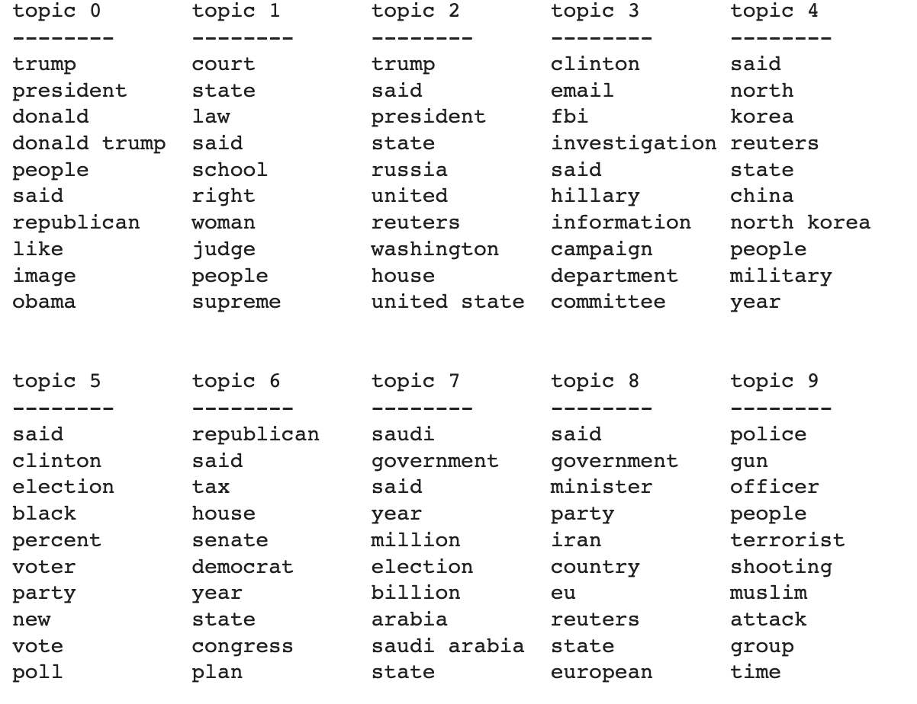
Topic Modeling - LDA
Notes:
Jane

Slide 18
Models

Slide 19
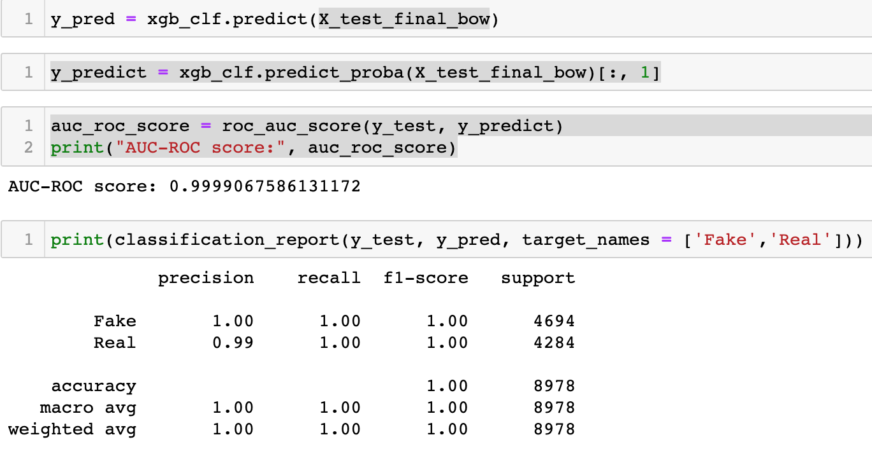
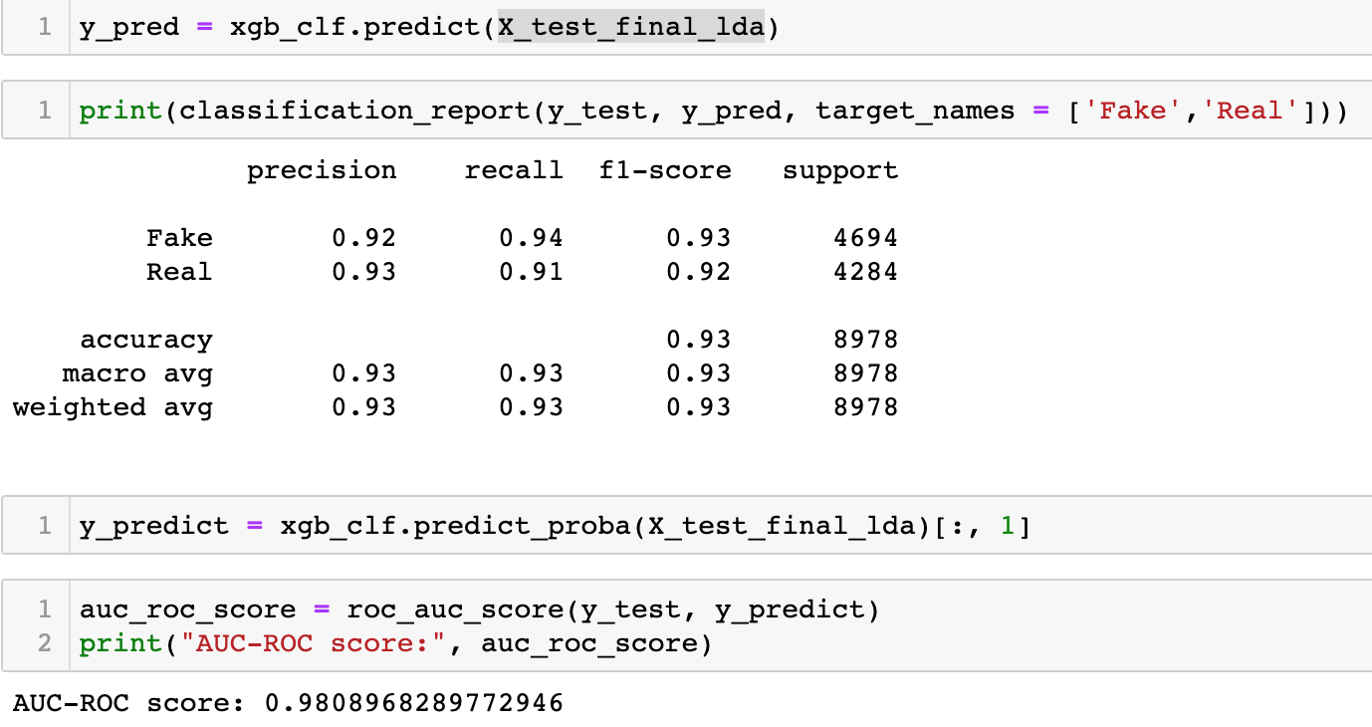
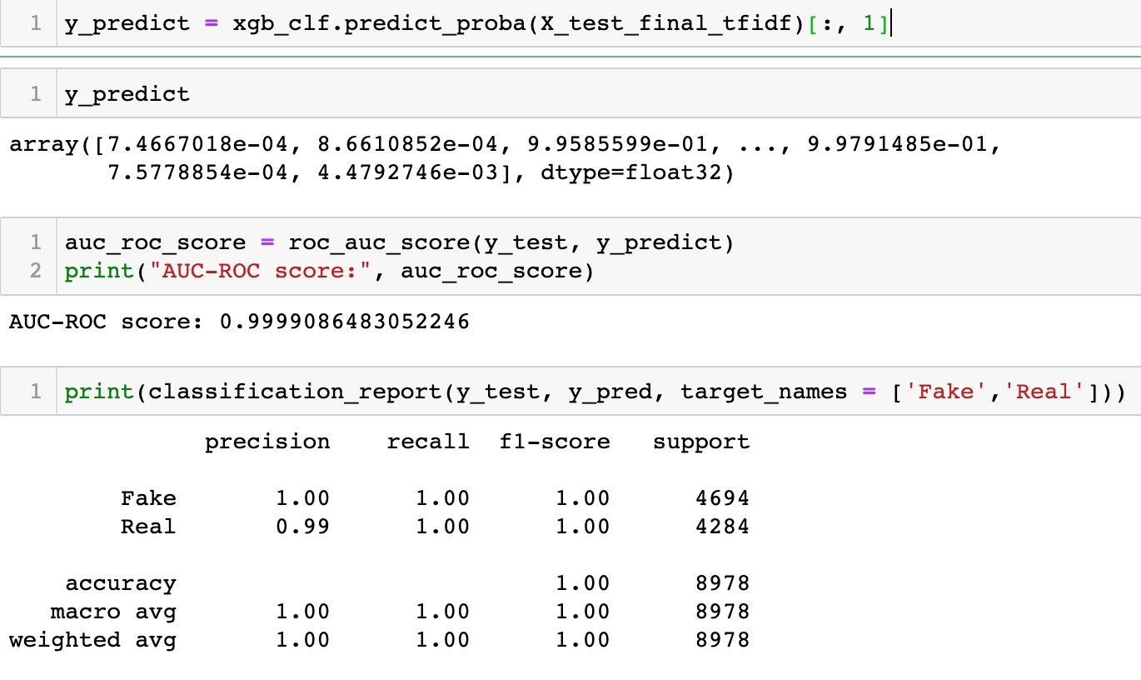
XG Boosting
Notes:
Jane

Slide 20
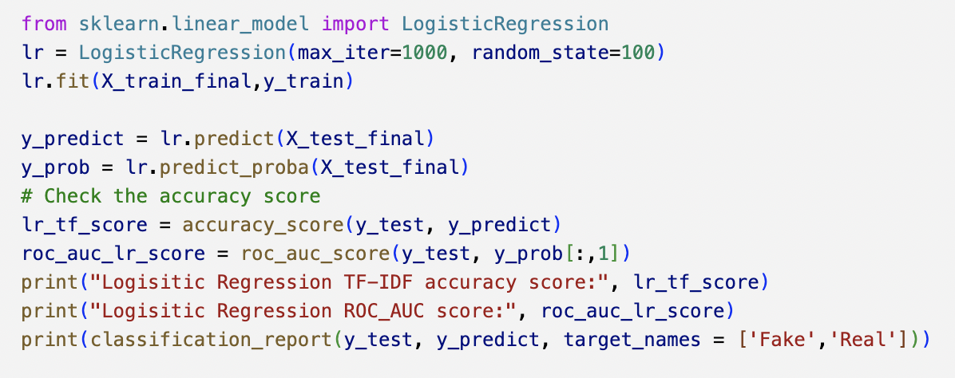
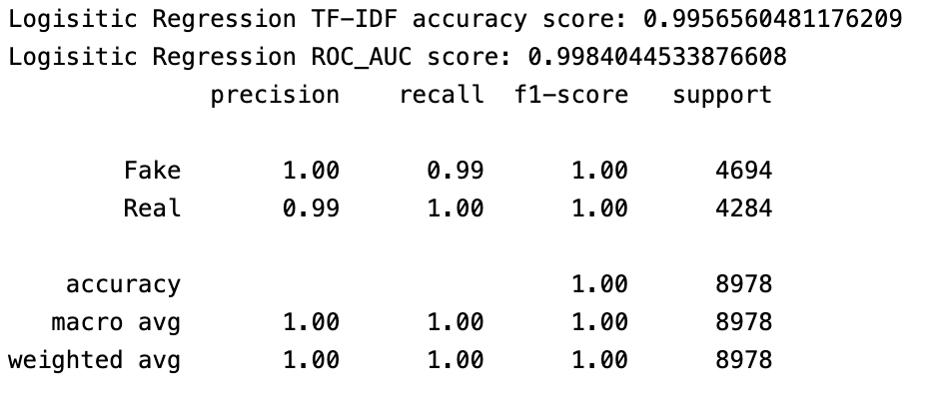
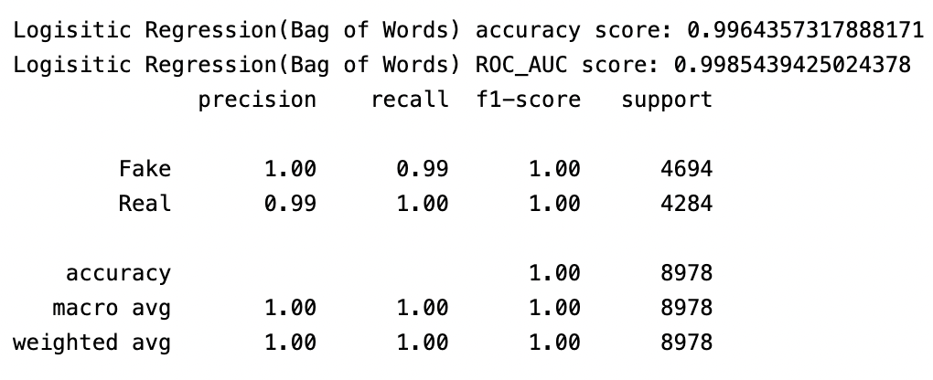
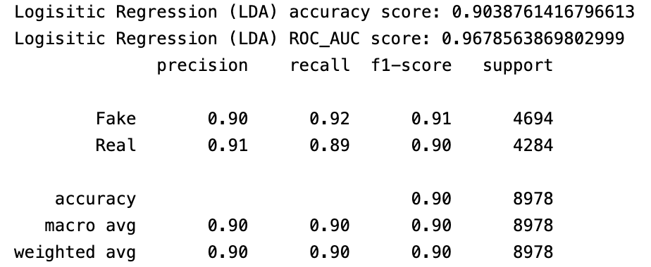
Logistic Regression
TFIDF
Bag of Words
LDA
Notes:
We fit logistic regression model on training data and then evaluate its performance using accuracy score, ROC AUC score, and classification report. In TF-IDF and BOW, the classification report shows high precision, recall, and f1-score values for both classes, indicating that the model is performing well for both classes in these method. With LDA we have 90% precision and recall.

Slide 21
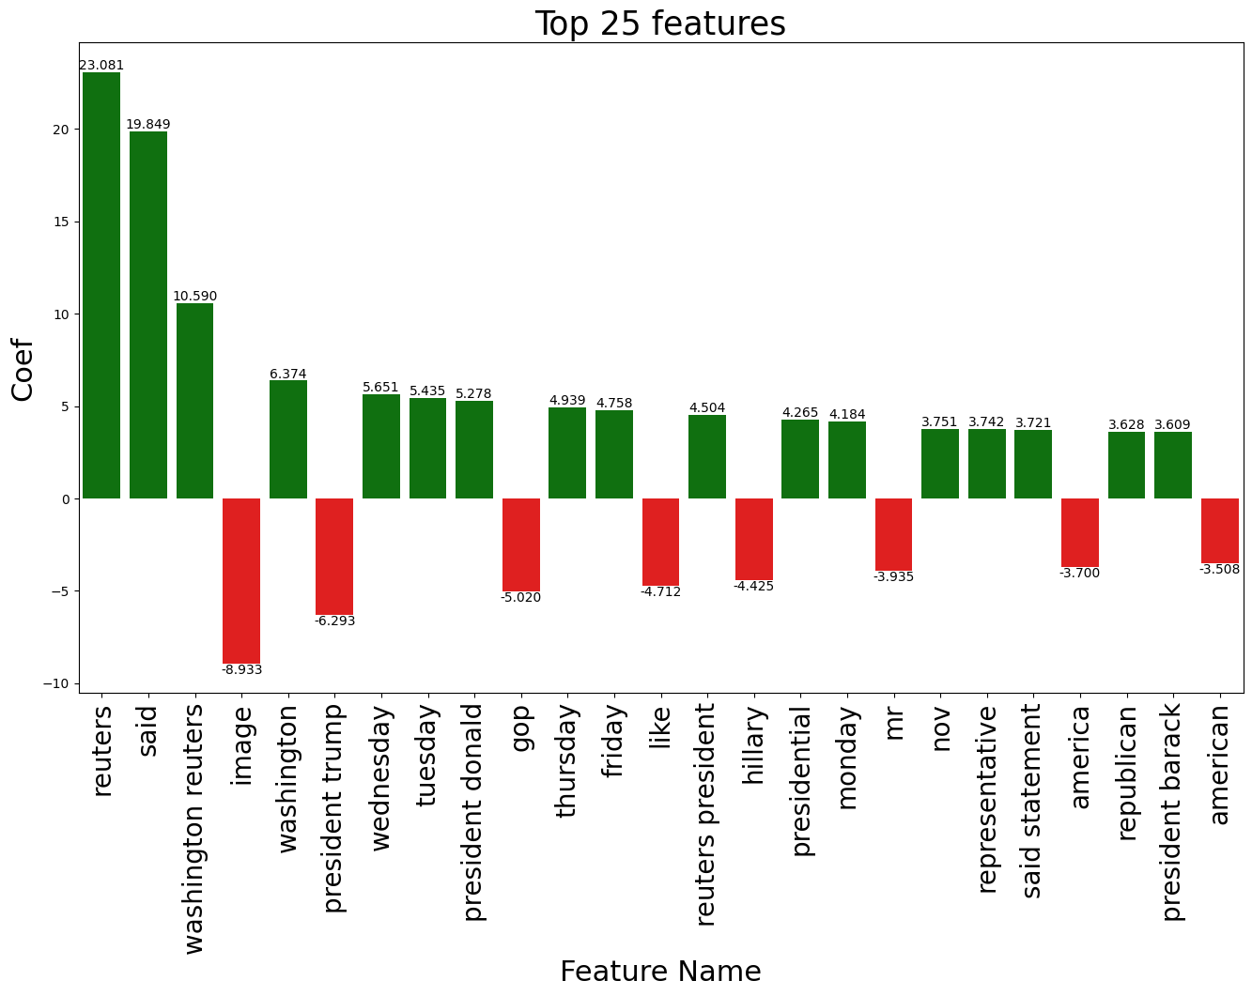
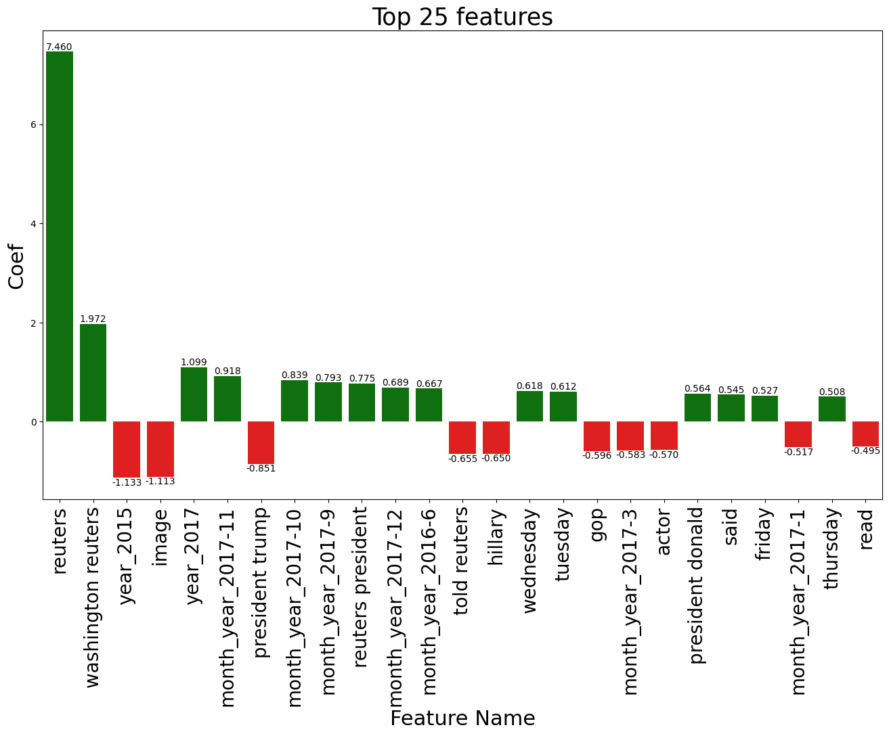
Feature Importance
TFIDF
Bag of Words
Notes:
While analyzing The feature importance of TF-IDF and BOW models we found out -
Words like "Reuters" and "Washington Reuters" have been found to have high importance in identifying the authenticity of news.
This can be attributed to the fact that "Reuters" is a well-known news agency and appears frequently in authentic news articles, as confirmed by the word cloud analysis.
As a result, the presence of such tokens significantly contributes to the model's accuracy in distinguishing between real and fake news.
These findings suggest that incorporating domain-specific knowledge into models can enhance their performance in tasks such as fake news detection.

Slide 22
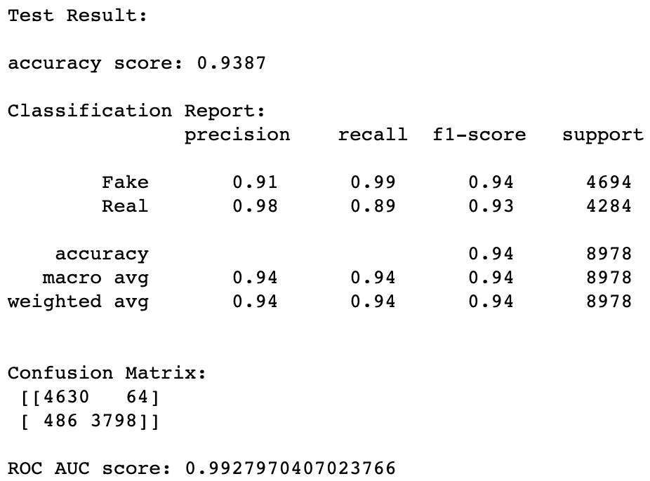
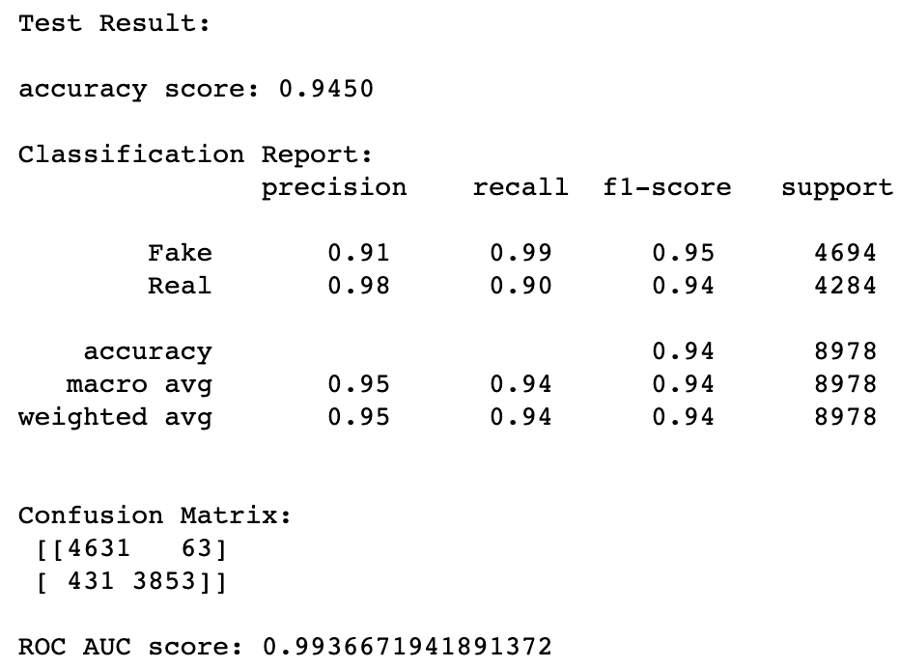

Random Forest Classifier
TFIDF
Bag of Words
LDA

Slide 23
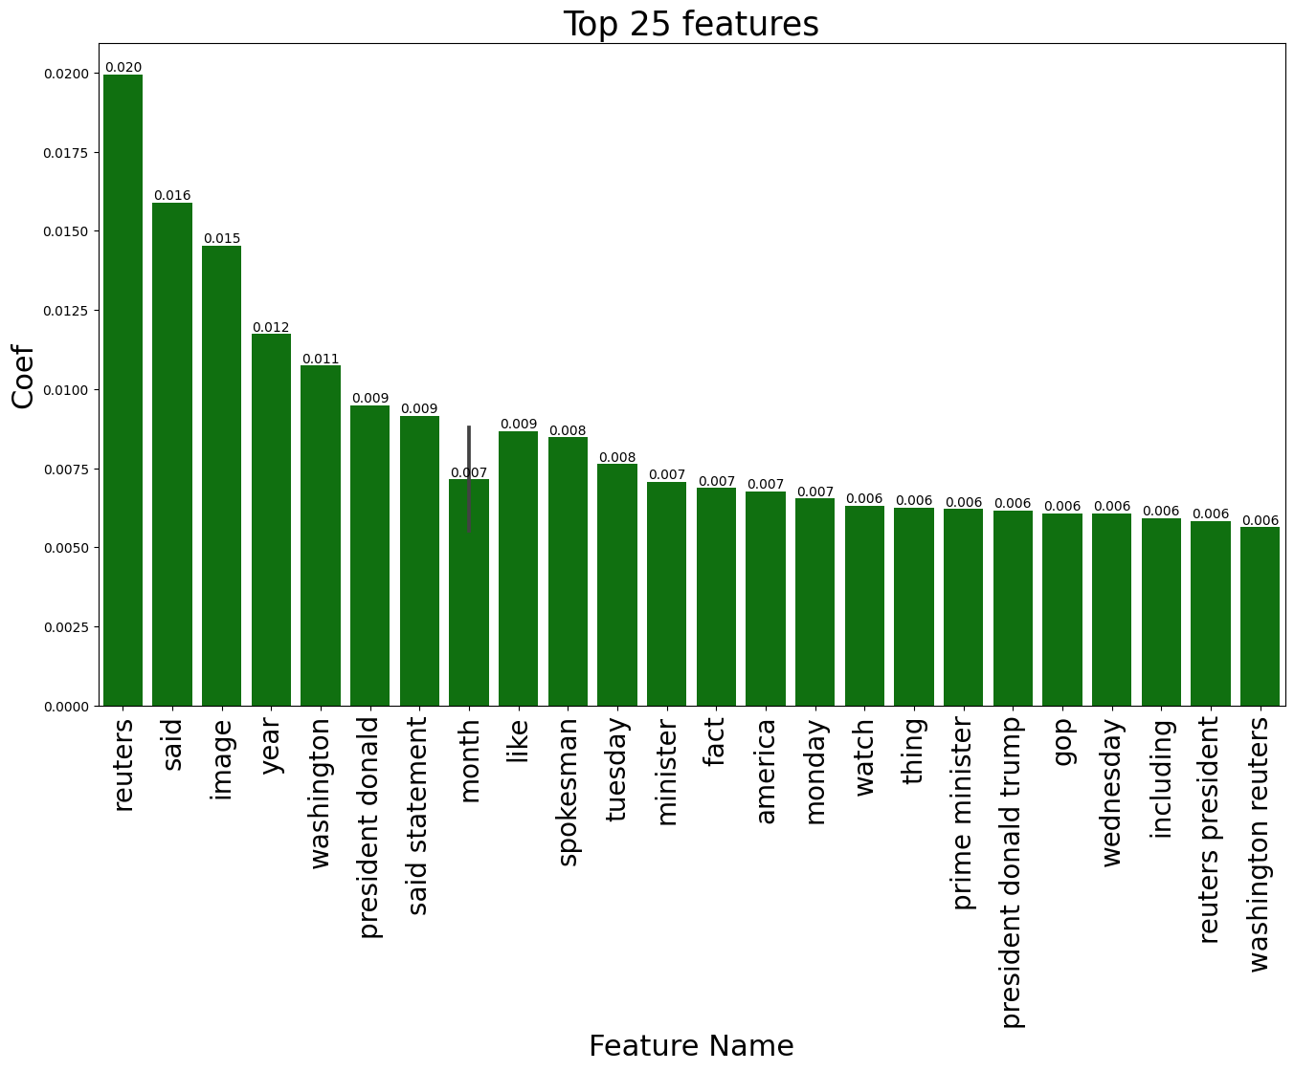
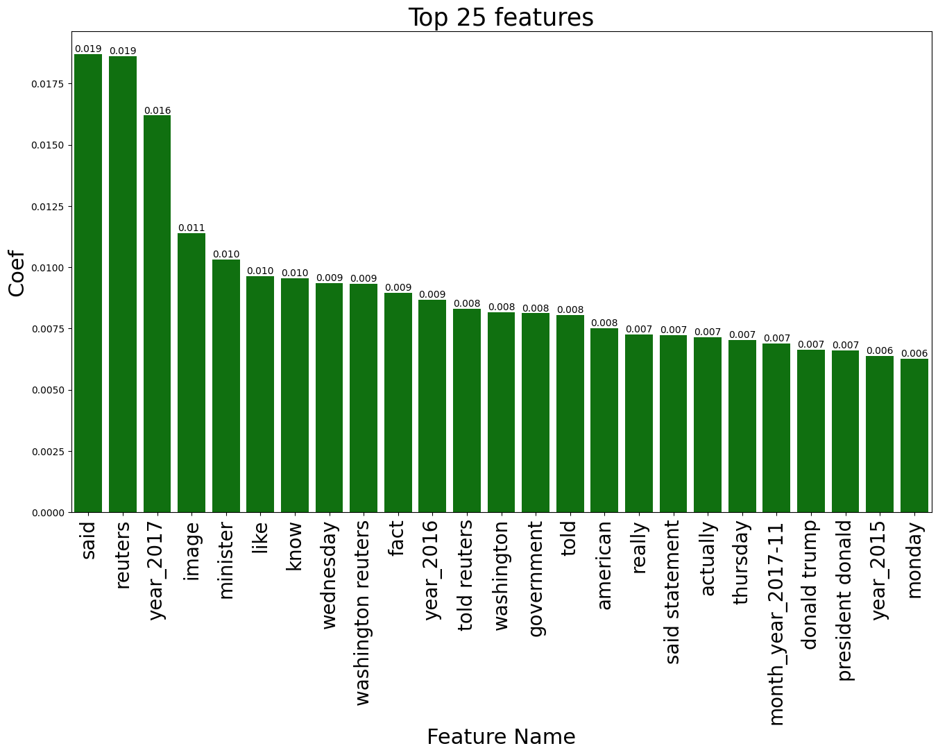
Feature Importance
TFIDF
Bag of Words

Slide 24
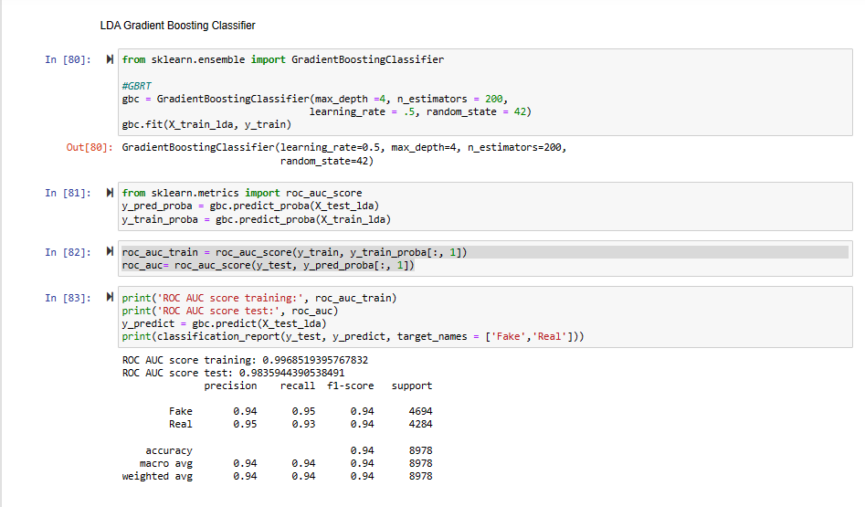
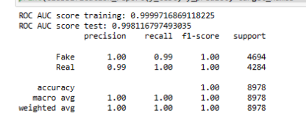
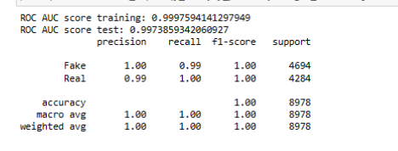
Gradient Boosting Classifier
TF-IDF Data using GBC
BOW Data Using GBC
All models ran using same parameters, to see how the different data processing effects model

Slide 25
Conclusion
1
2
3
4
All models performed well
Optimism
Balanced
Overall
Could get above 90% accuracy with good recall and precision
Fake news as based on the dataset, may be easy to identify using Machine Learning
Perhaps there is overfitting going on, or a unique vs general finding
We believe using AI to screen for highly likely fake news will be crucial in the future
10%
25%
25%
40%

Slide 26
Key Applications of these Models
A few examples of where this technology could be used
1
Search Engine Filtering
Google, Bing etc.
2
Flagging users for review who post links to likely fake news articles
Content Moderation
3
Only select the most reputable info to source in responses
AI Chatbot Optimization
4
Screen the drafts of internet posts to ensure they aren’t spreading mis-info, potential ethical issue?
Pre-Post Screening?

Slide 27
Key Learnings
Visualize data before cleaning really helps to see how the raw data is like.
Found different ways to add other features back in with the processed text
Even though some data are numerical, we can consider turning them into categorical— scaling
Sometimes ‘english’ stopwords are not enough. Have to always do sanity check
LDA doesn’t necessarily help with the accuracy

Slide 28
Thank You

